Slide 1
Kickoff Meeting Fall 2021
Competitive Programming Club

Slide 2
What is Competitive Programming?
Coding Puzzles/ Interview Type Problems
Any Programming Language
Any Skill Level

Slide 3
Our Team
President: Michael Appugliese
Vice President: Russell Zhu
Treasurer: Yifan Zhu

Slide 4
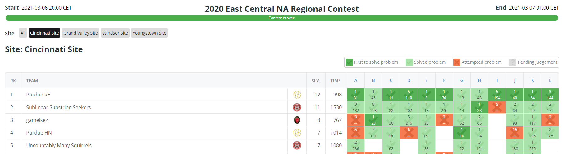
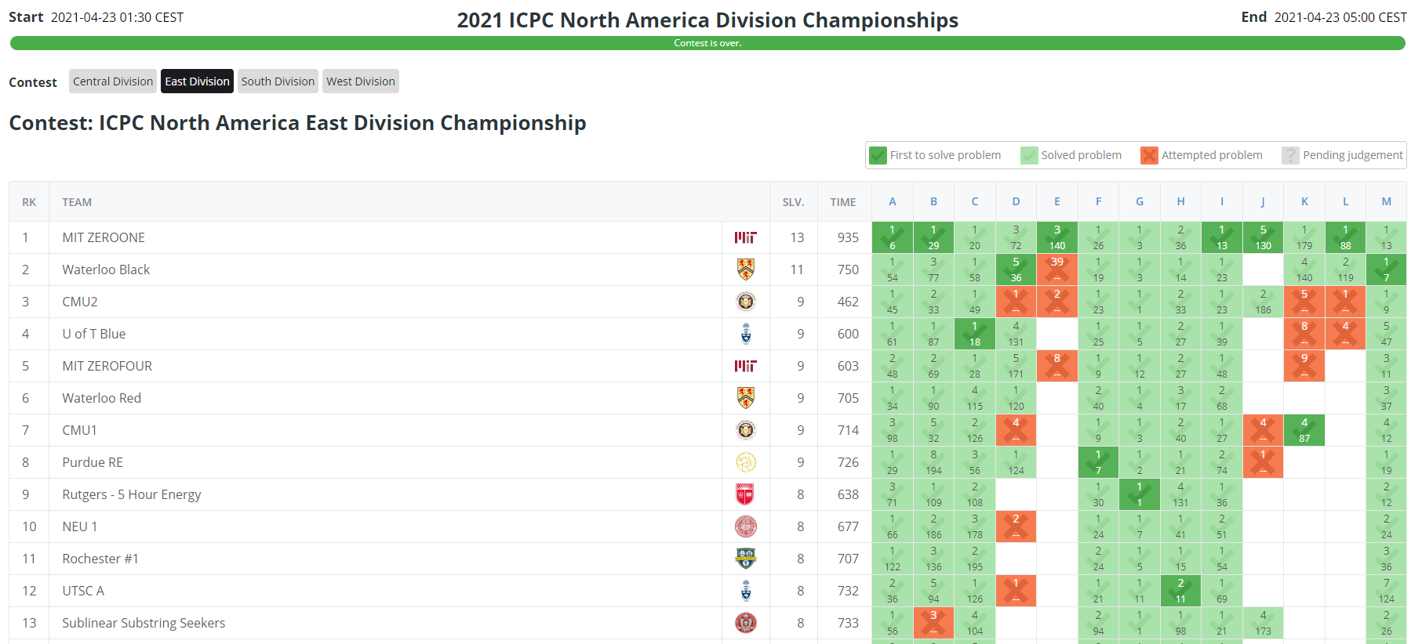
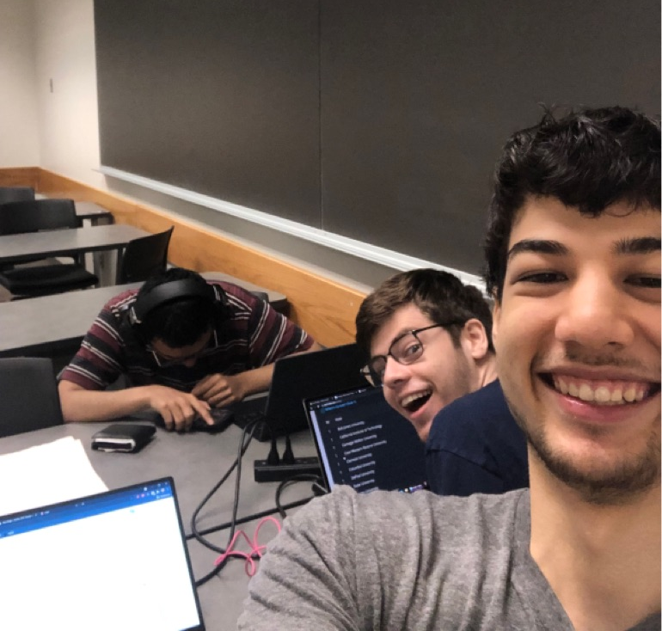
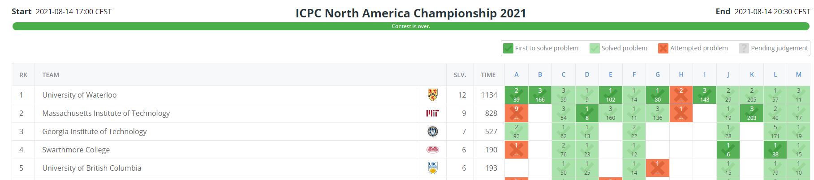
Competitions
ICPC
Google
CMIMC
...
...
...
Notes:
Russell can talk about this.
Google Code Jam and Hash Code Spring Registration, Kickstart happening soon
Carnegie Mellon math and cs competition, first year cs last year, missed registration

Slide 5
Our Club
Practice Competitions
Lectures
Mock Technical Interview
Closing Ceremony
Logo and T-Shirt Design

Slide 6
Coding Game!

Slide 7
Discord
go.osu.edu/cpcdiscord
discord.gg/WmPGNRV
GroupMe
go.osu.edu/cpcgroupme
tinyurl.com/yydkcghy
Today’s Agenda:
go.osu.edu/cpckattis
Attendance Form
go.osu.edu/cpcattendanceform
Notes:
https://osu.zoom.us/j/99865271480?pwd=YlYzMVhxMzh0ZzZsUzhoWngxZGw4UT09

